Slide 1
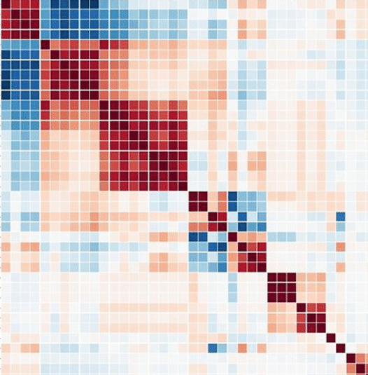
pyspi: python toolkit for statistical analysis of pairwise interactions
Package author: Oliver Cliff
Workshop presenter: Annie G. Bryant
16 July 2022
Gonna turn this into a cool graphic
Link to repo
QR code to repo

Slide 2
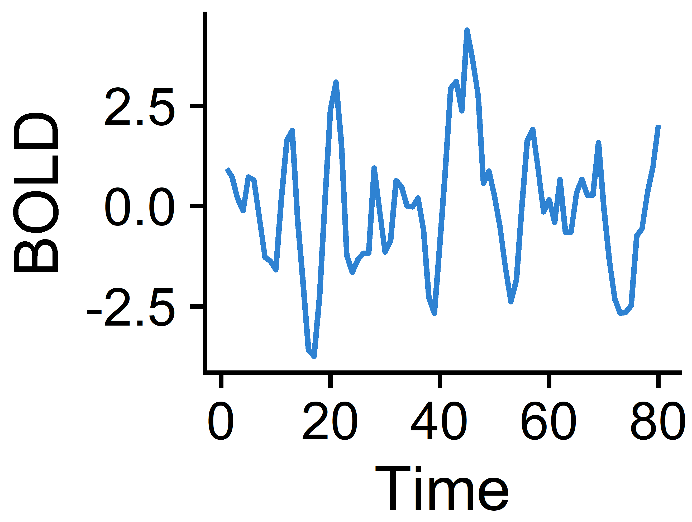
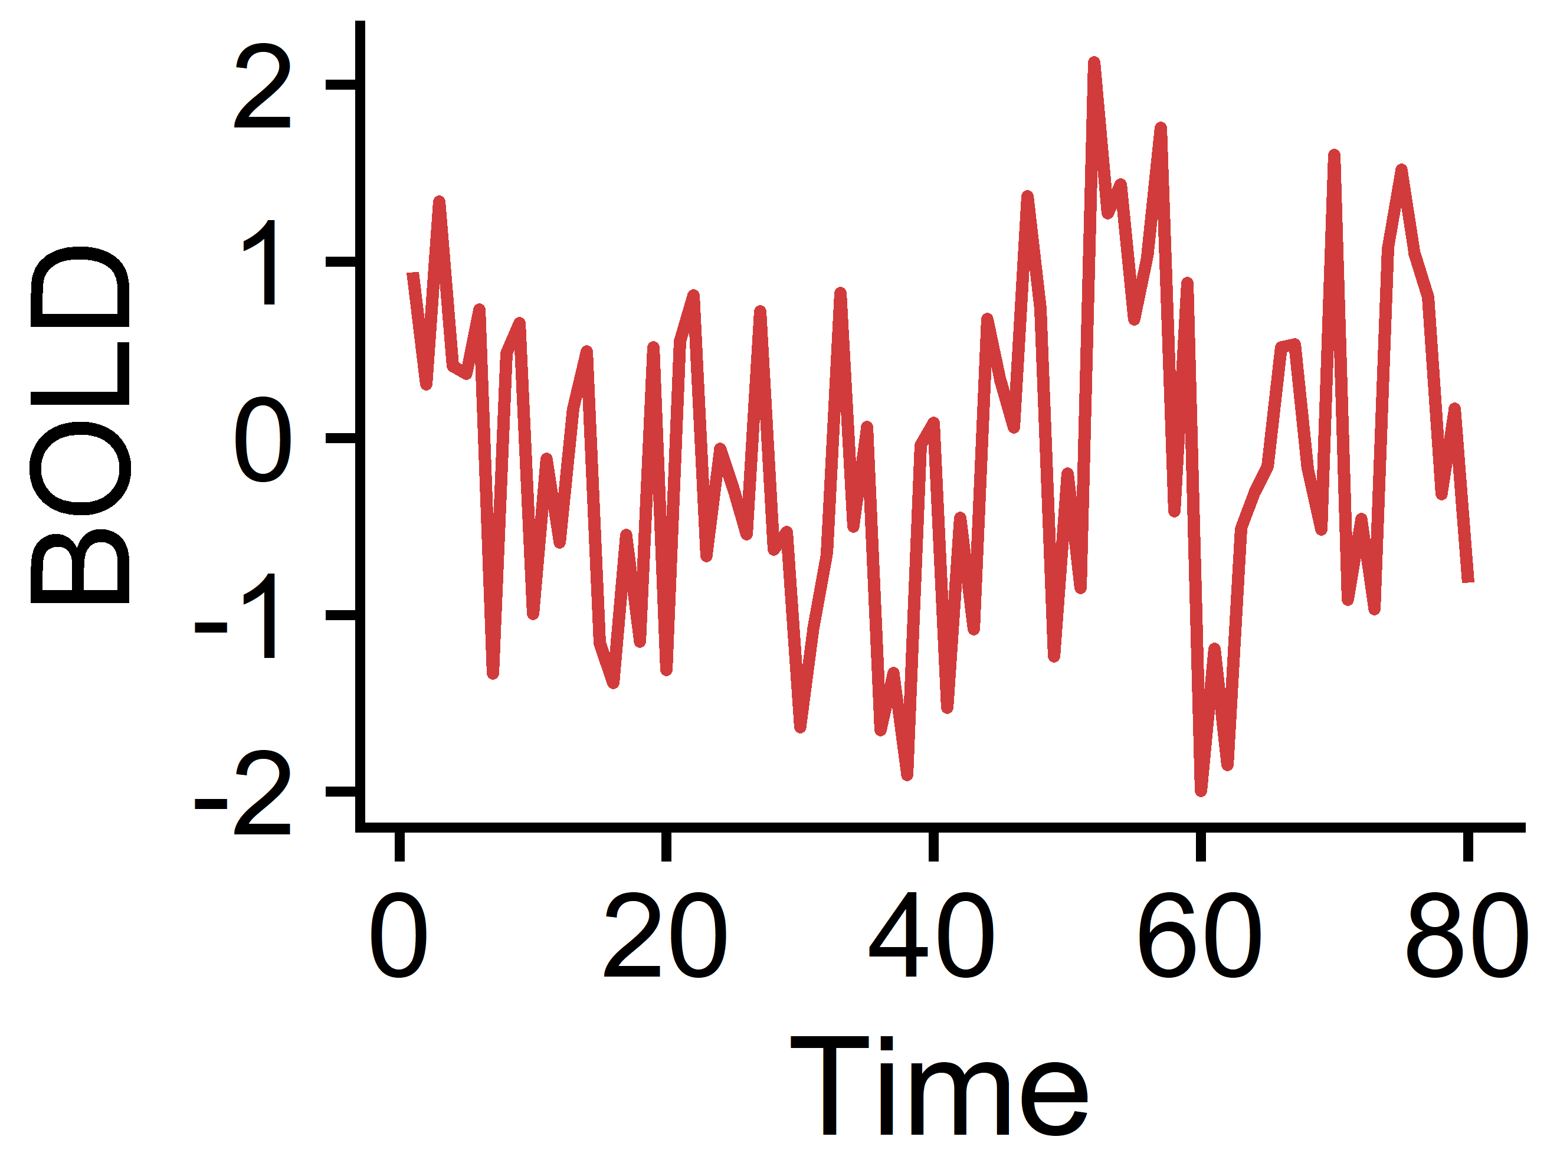



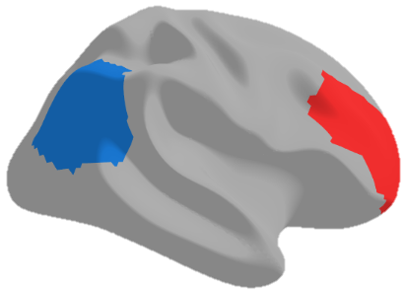
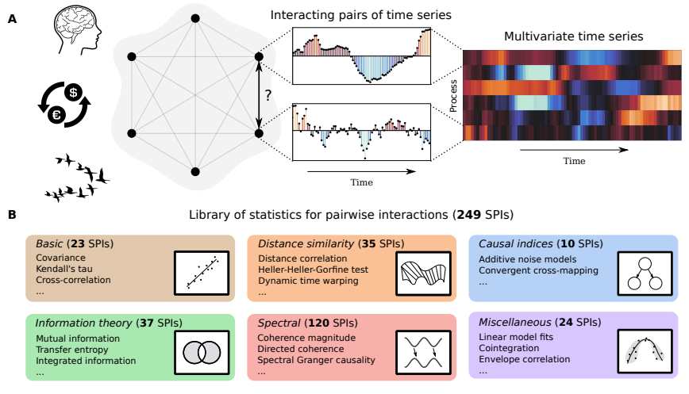
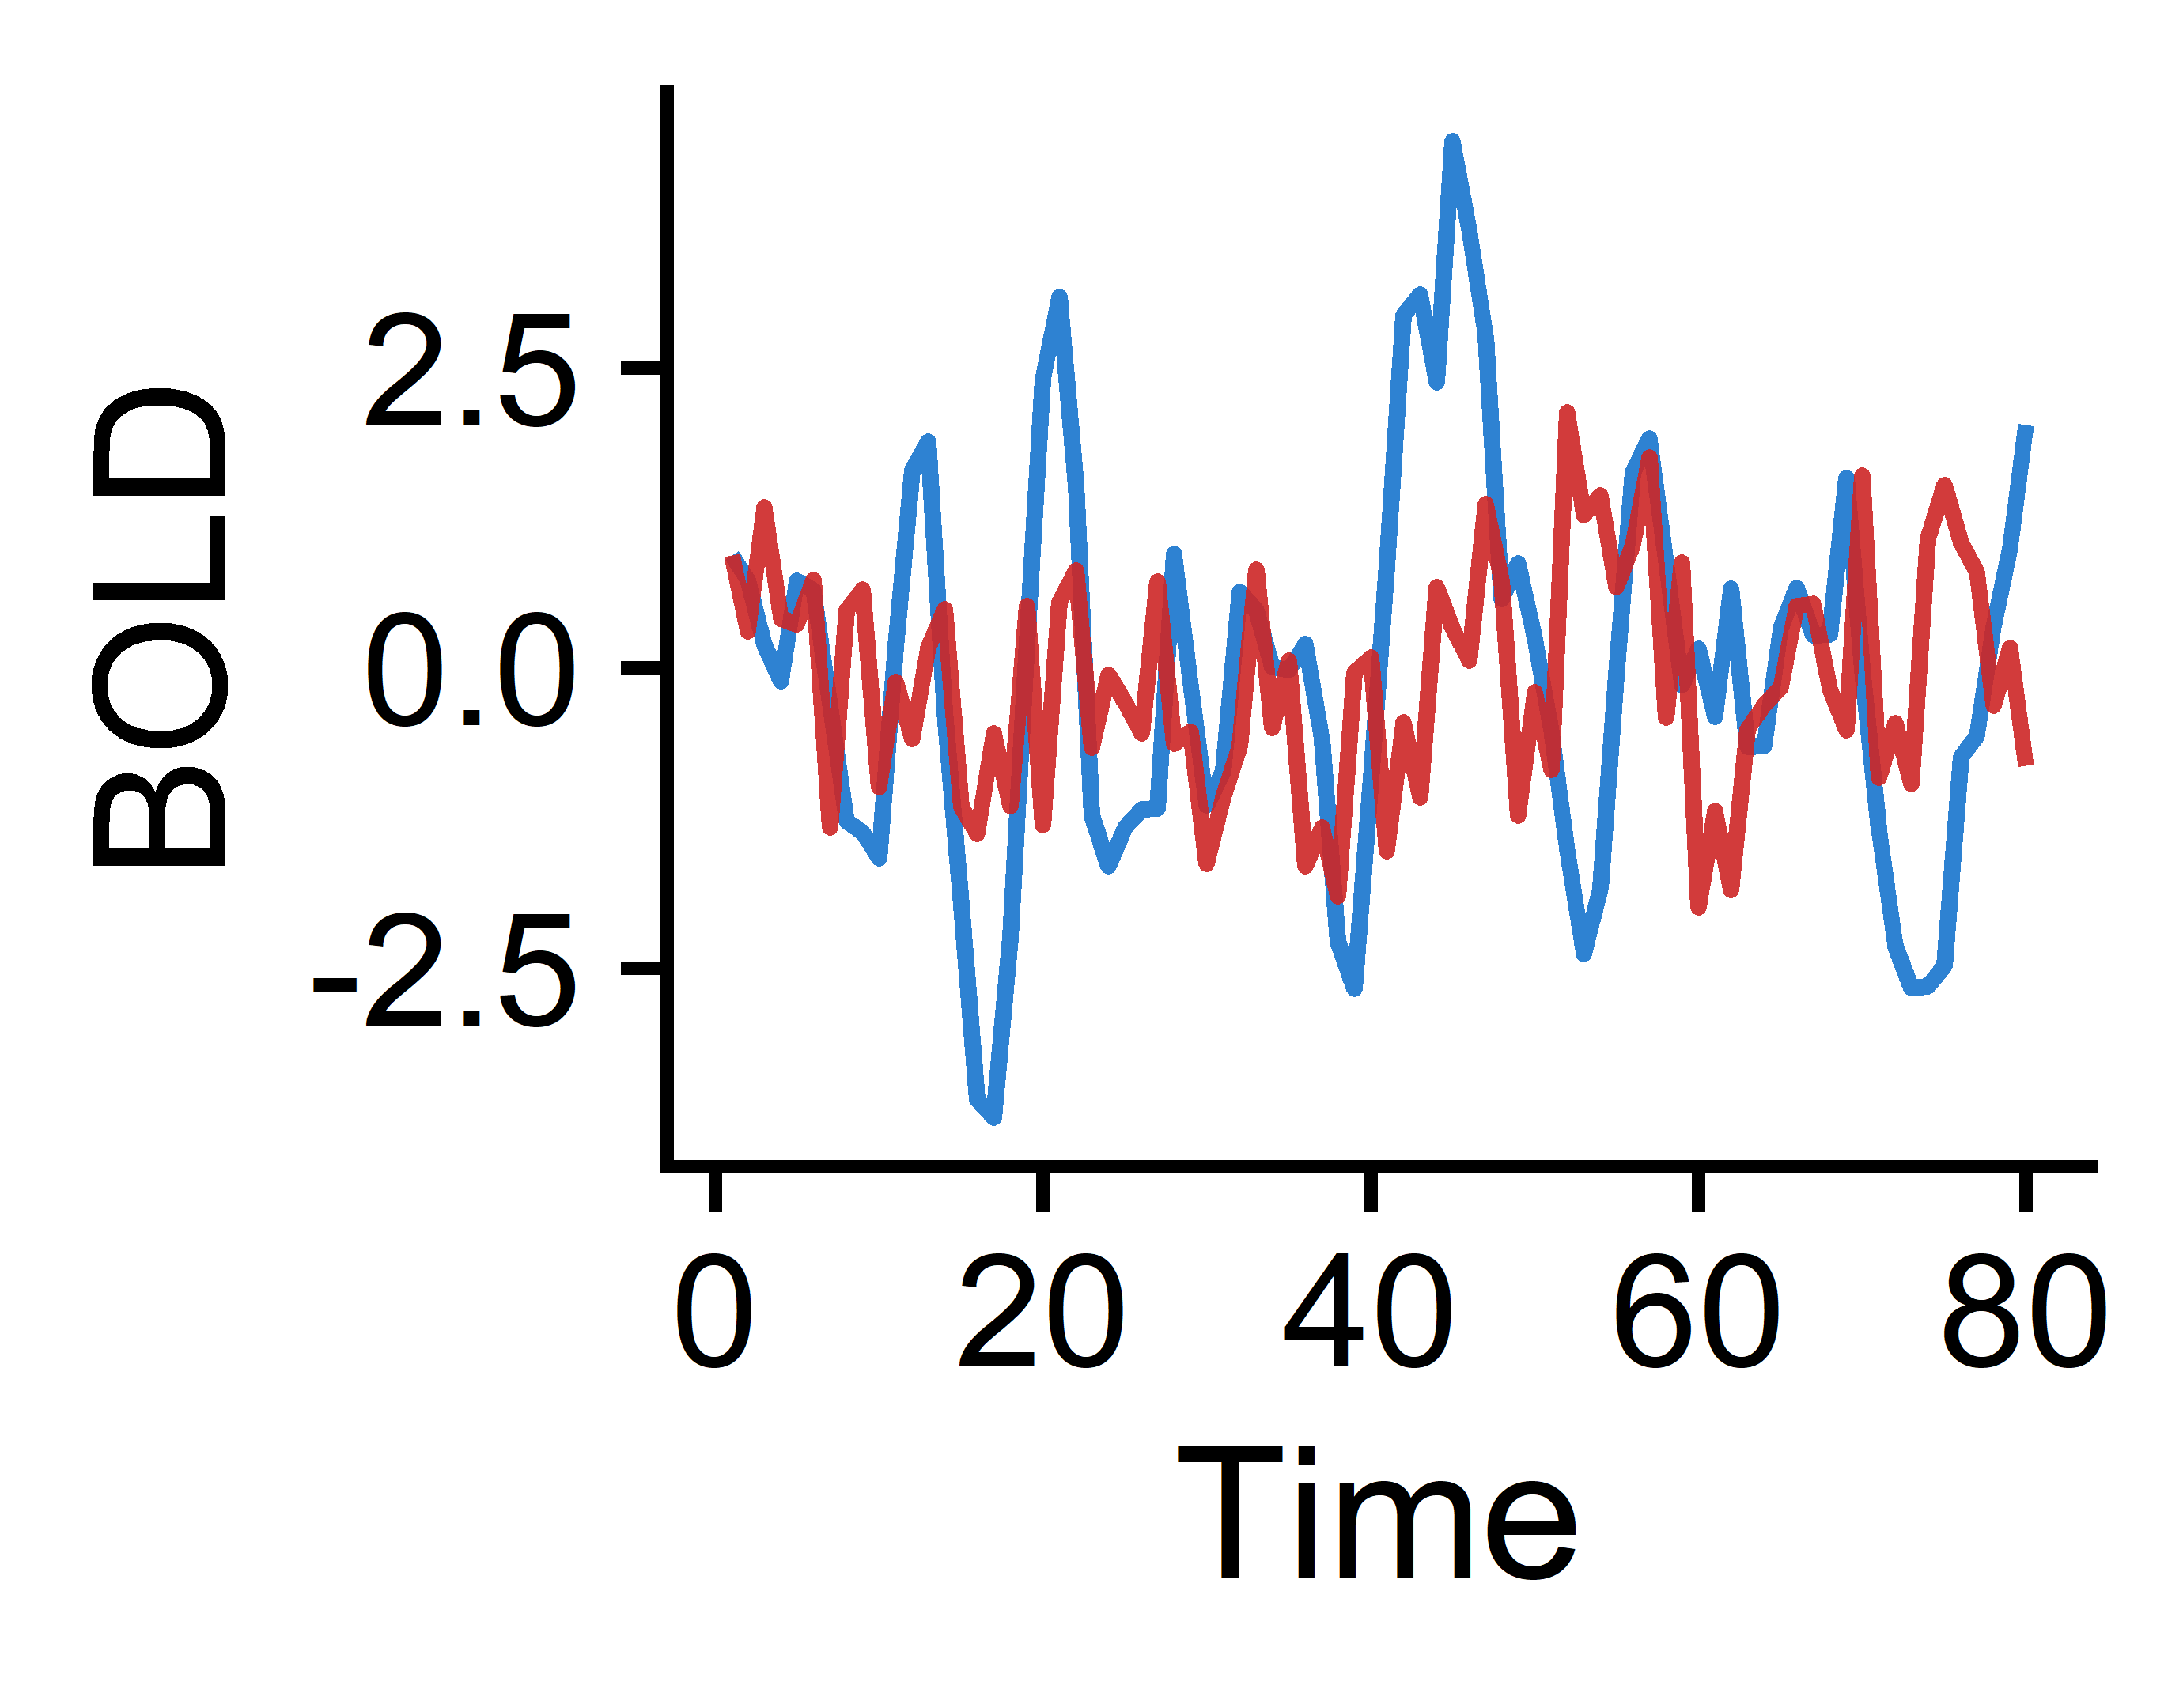
Intro to theft and pySPI for univariate + pairwise time-series feature extraction
Univariate time-series feature extraction
Pairwise time-series feature extraction

Slide 3
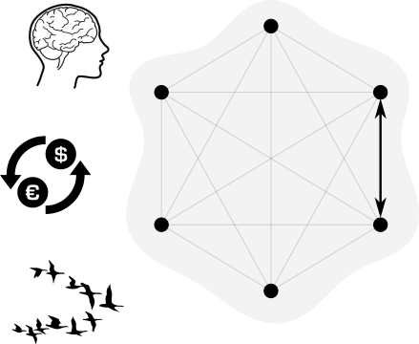
Understanding pairwise interactions in general
Used in every discipline
Neuroscience
Connectivity measures
Econometrics
Interactions b/w assets
Earth systems science
Dependence within ecosystems
Biology
Leader/follower in collective motion
Slide courtesy of Oliver Cliff

Slide 4
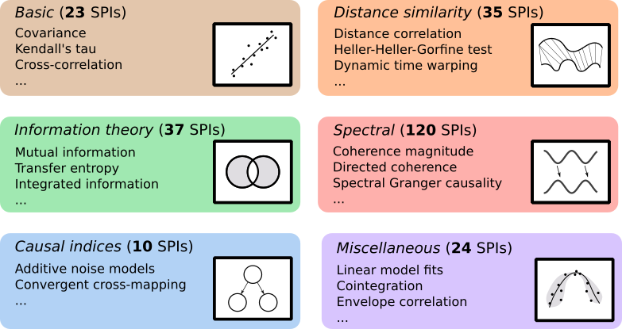
Leveraging pairwise interactions to understand brain network dynamics
Typical workflow: calculate Pearson correlation between time series and construct a brain functional connectivity matrix
What pySPI offers: comprehensive library of up 250 pairwise interactions (SPIs) that span diverse time-series literature domains
Multivariate time series
Regional BOLD fMRI signals
Cliff et al. 2022 (arXiv)

Slide 5
Let’s get pySPI running!
Key links
https://github.com/olivercliff/pyspi
https://pyspi-toolkit.readthedocs.io/en/latest/
https://wiki.octave.org/Category:Installation
https://www.anaconda.com/products/distribution
Quick steps to install
[OPTIONAL] install octave on your machine from above link
[OPTIONAL] create a specific conda environment for pySPI
conda create –n pyspi python=3.9.0
conda activate pyspi
Clone the pySPI github repo to your machine
e.g. git clone https://github.com/olivercliff/pyspi.git
Navigate to downloaded repo
e.g. cd ~/pySPI
python3 –m pip install .

Slide 6

Applying pyspi to BOLD fMRI time-series data
Tutorial data: one participant from the UCLA Consortium for Neuropsychiatric Phenomics LA5c Study
10 example brain regions included, each with 152 BOLD fMRI time points

Slide 7


Live coding demo
Applying pyspi to BOLD fMRI data to extract a subset of SPIs
(pre-rendered jupyter notebook)
Porting resulting pairwise metrics to R for downstream visualization and analysis
(pre-rendered R markdown notebook)

Slide 8
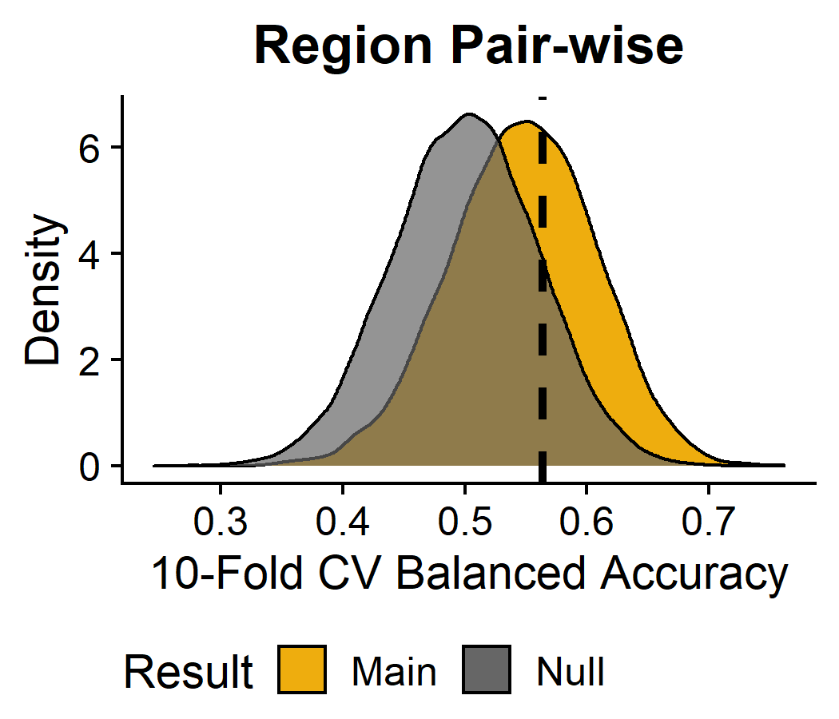
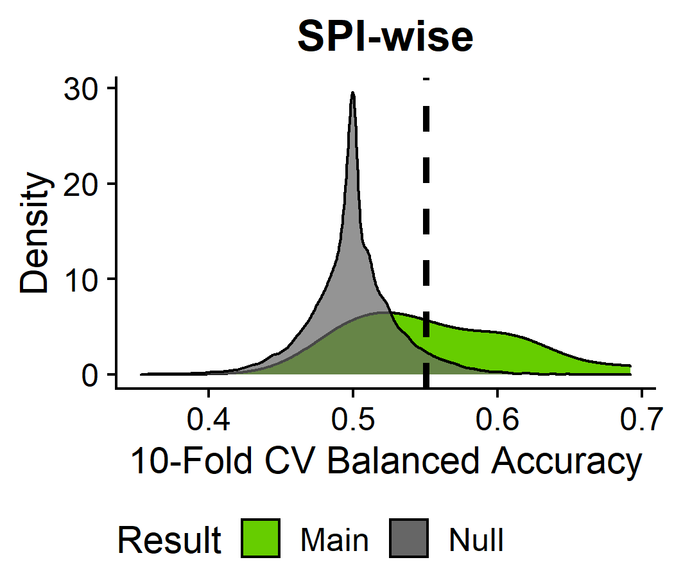
Downstream application example: classifying schizophrenia from control patients based on pairwise neural interactions
Double-check the p-value line here?
For each pair of ROIs (n=6,642), linear SVM was run using a subset of 19 SPIs
For each SPI (n=19), linear SVM was run using all ROI pairs (n=6,642)

Slide 9
Thank you & acknowledgments
Oliver
Ben
Add contact info for everyone
Presenting author: Annie Bryant

